Slide 2
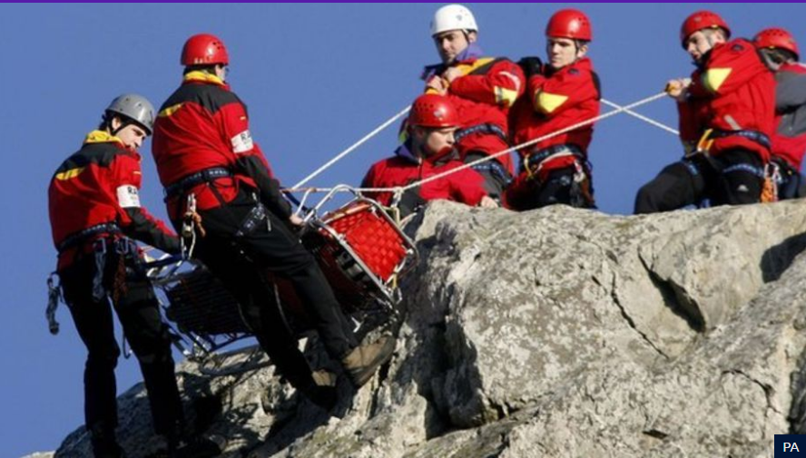

Slide 3
Who are they?
Mountain rescue teams around the UK carry out about 1500 rescue missions a year.
(that’s one rescue everyday for just over 4 years)

Slide 4
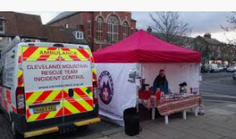
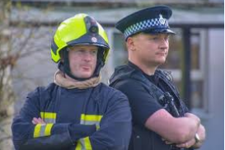
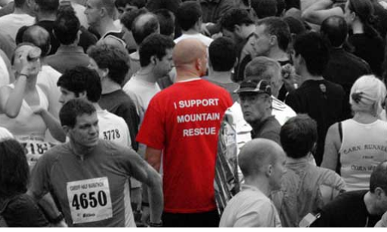
They work alone or alongside other teams like police and firefighters but unlike them, mountain rescue is not funded by the government.
.

Slide 5
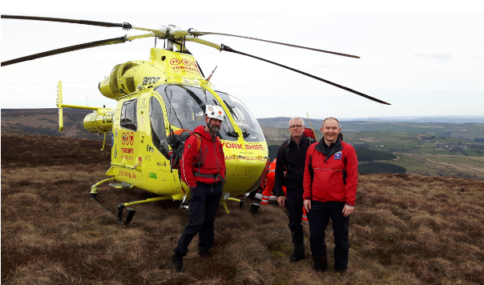

Slide 6
They’re a charity, which means all the people who carry out the rescues are volunteers and money constantly has to be raised to pay for the equipment and vehicles they need.

Slide 7
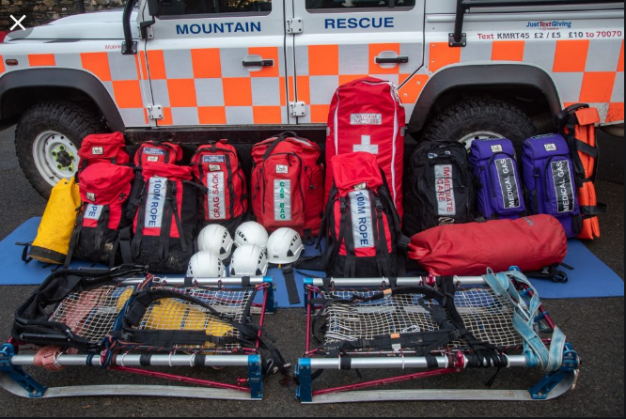

Slide 8
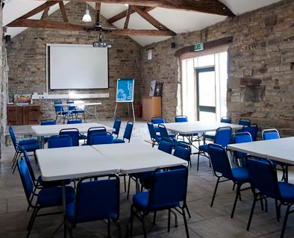
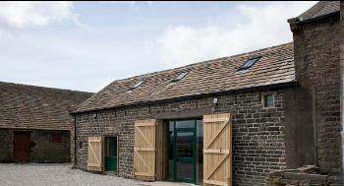
Volunteers work from mountain rescue bases all around the UK but don't stay there all day and night.

Slide 9
Instead, they are on call 24 hours a day and are alerted by phone if needed. That person then alerts the rest of the team and they meet at the base to gather equipment.

Slide 10
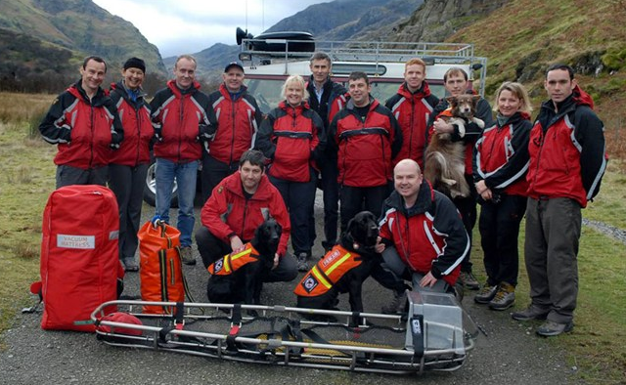

Slide 11
What do they do?

Slide 12
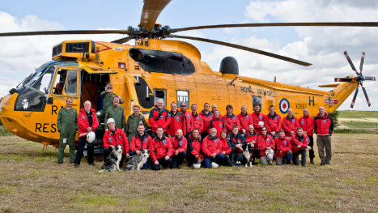

Slide 13
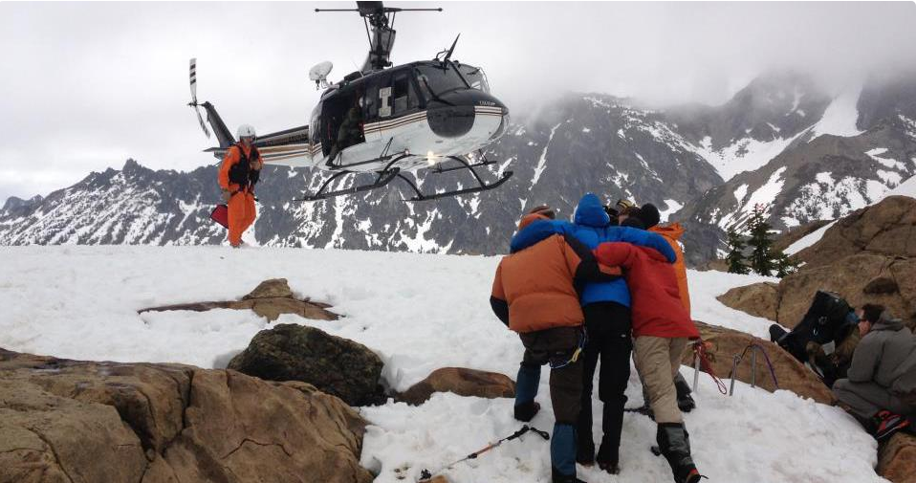
Mountain rescue are often called out to help walkers and climbers who might be lost, injured or in any danger.

Slide 14
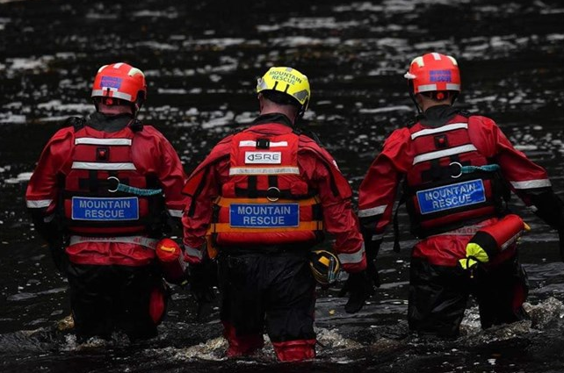
They also carry out river rescues and work with police in urban searches

Slide 15
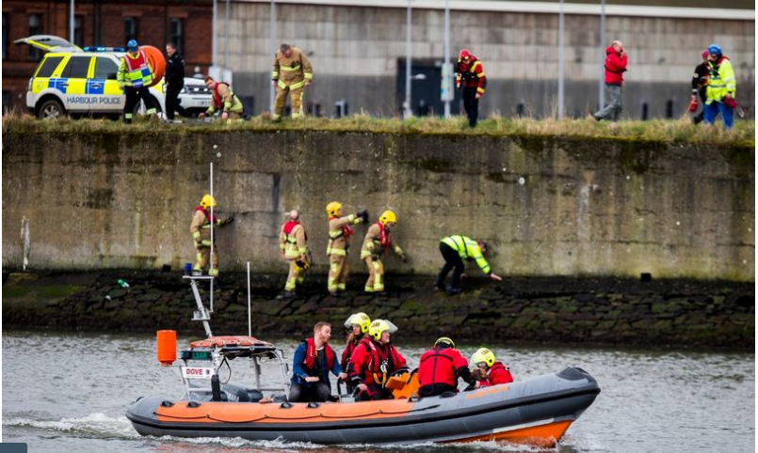

Slide 16
What equipment do they use?

Slide 17
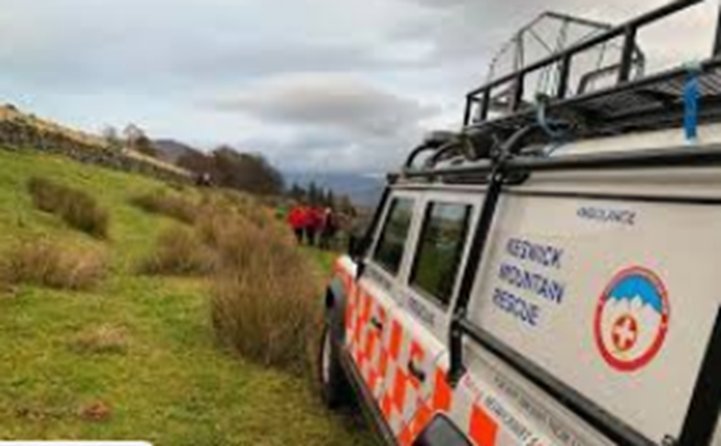
Mountain rescue use:
4x4 vehicles that can drive up steep hills and through water;

Slide 18
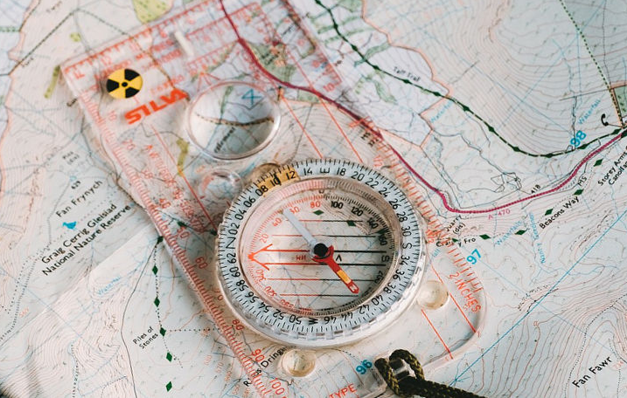
Maps and compasses to navigate;

Slide 19
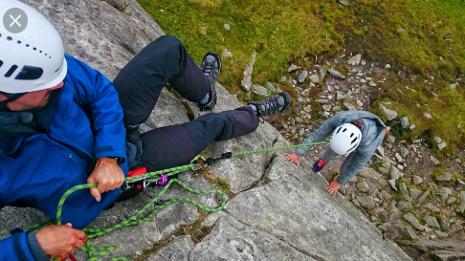
Rope to keep themselves safe climbing in dangerous areas;

Slide 20
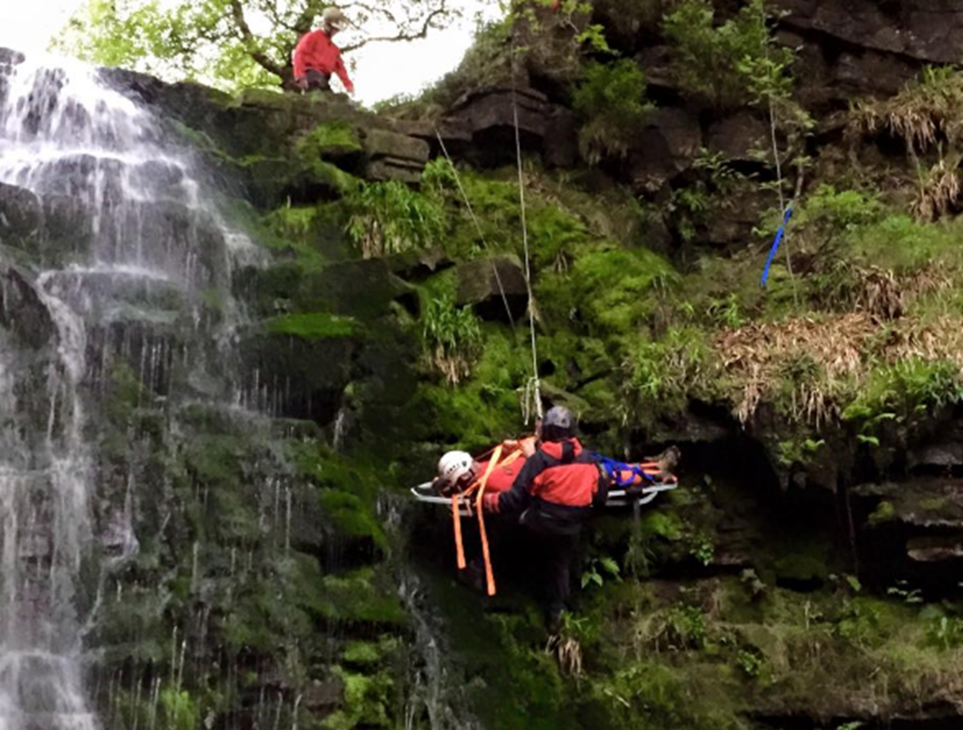
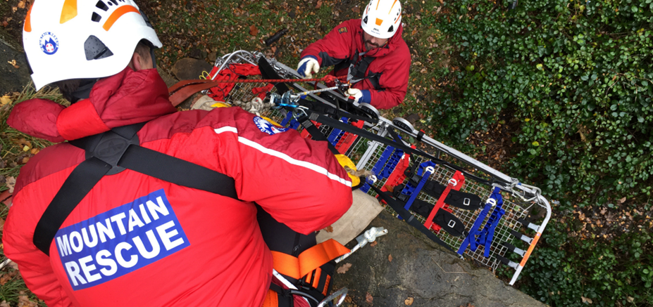
Stretchers to carry anyone who is hurt;

Slide 21
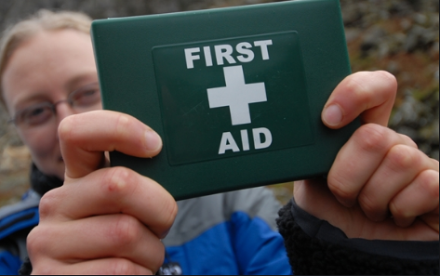
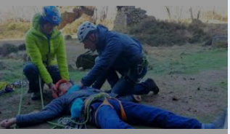
First aid kits to treat anyone who's injured

Slide 22
https://www.bbc.co.uk/cbbc/watch/p01lg3h4
Special Ops - 4x4 Mountain Rescue
https://www.youtube.com/watch?v=Jnvsjpe7MZY
Rescue Heroes™| Real Rescue Heroes | Alpine Search and Rescue | Live Action Episodes for Kids
https://www.youtube.com/watch?v=Au6b6AOW6v4
Mountain rescue team underway

